Slide 1

Classifying Severity of Colorectal Cancer
MIS 536 - Business Analytics
Professor : Dr. Moqri
Presented by:
Team 1 - Ajinkya Koshti, Kavita Jain, Ludmila Scott, Pallabi Chatterjee, Tyler Kutz

Slide 2
RECAP
Colorectal cancer is the second leading cause of cancer death in USA
One in three people are not up-to-date with colorectal cancer screening.
60% of colorectal cancer deaths could be prevented with screening
Colorectal cancer is a public health issue
Correctly classifying how severe someone’s cancer is important because:
Determines treatment plan
Predicts chance of recovery
Help identify clinical trials
Sets expectations

Slide 3
Agenda
Data Overview
Data Prep
Roadblocks
Model Selection
Prediction
Accuracy
Insights

Slide 4
About Data
https://seer.cancer.gov/data/access.html
The Surveillance, Epidemiology, and End Results (SEER) Program of the National Cancer Institute (NCI) collects and publishes cancer data through a coordinated system of strategically placed cancer registries which cover near 30% of the USA population. Currently there are 18 SEER registries in the USA.
939119 observations
33 categorical variables
35 variables
2 numerical variables

Slide 5
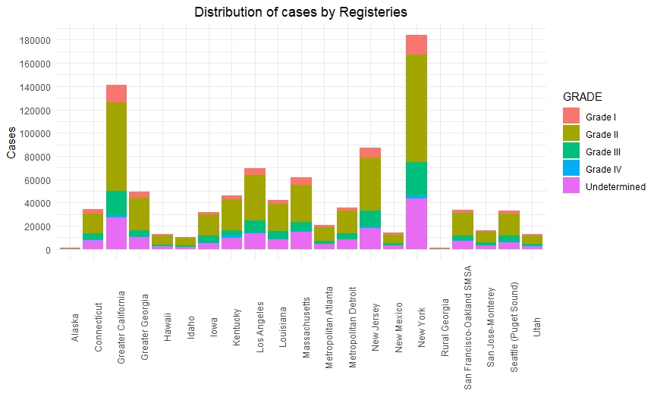
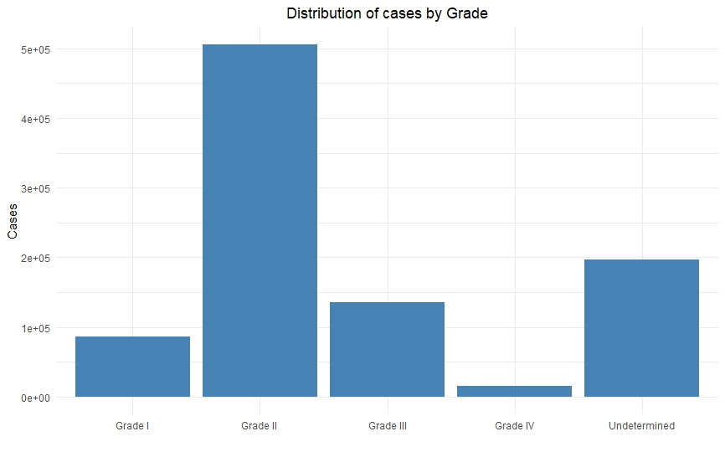
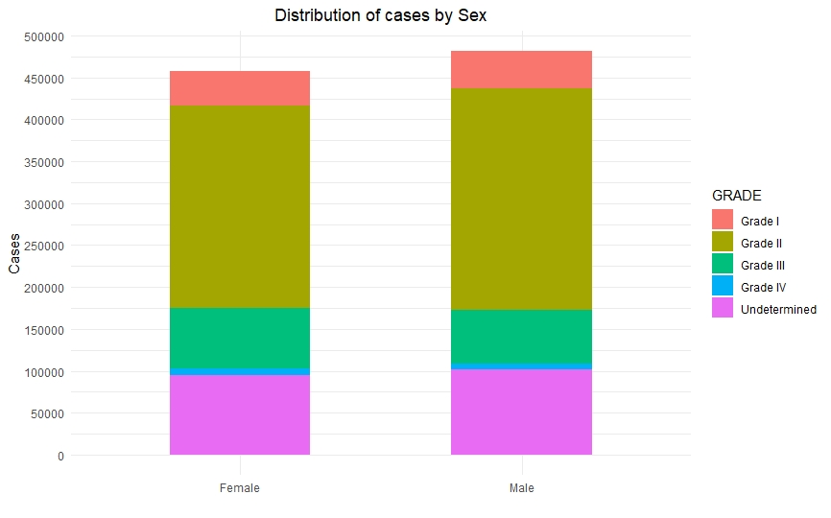
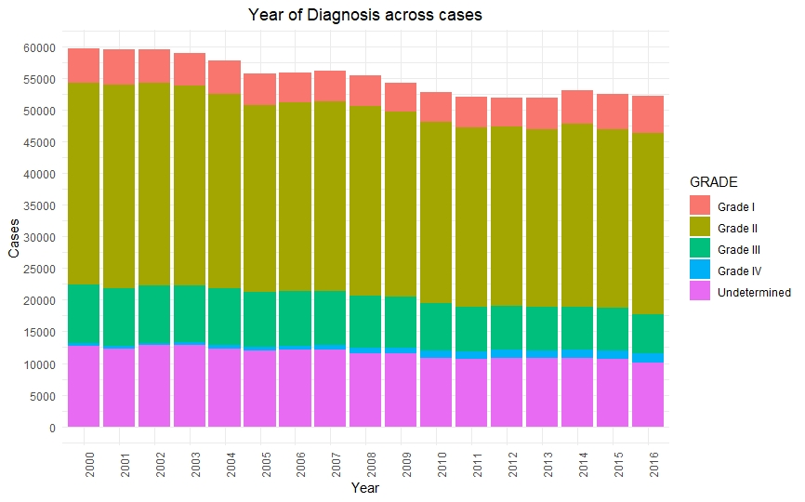
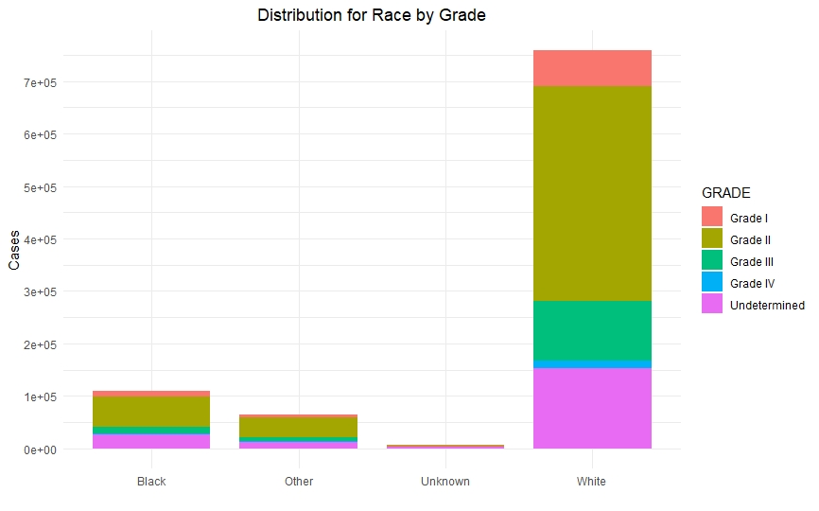
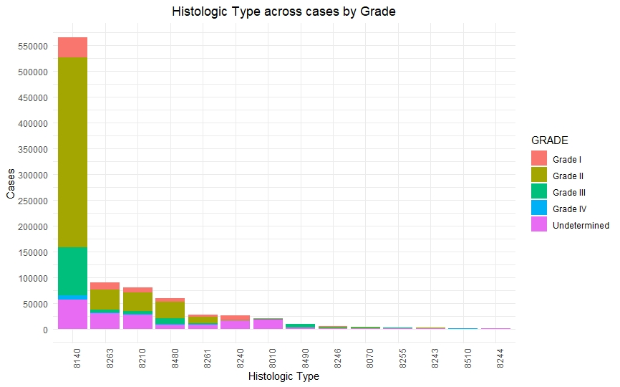
Data Exploration

Slide 6
Steps to Preprocess Data
Data Formatting - Converting encoding ASCII files into CSV files, decoding them to explore the data.
Sampling – we conducted weighted sampling (stratified sampling) to facilitate data reduction for exploratory data analysis and scaling up algorithms to big data applications and quantifying uncertainties due to varying data distributions.
Transforming the data - we transformed our data, created dummy variables also binning our response variable i.e., Grade I, Grade II, Grade III, Grade IV into two categories 0 (combining Grade I & Grade II) and 1 (combining Grade III & Grade IV).

Slide 7
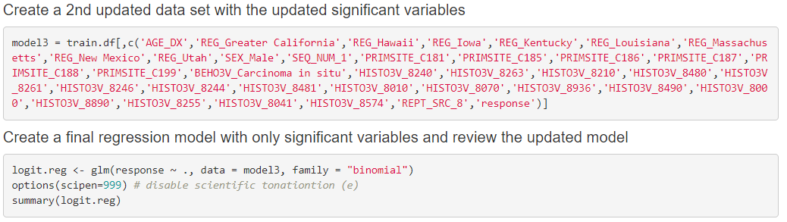
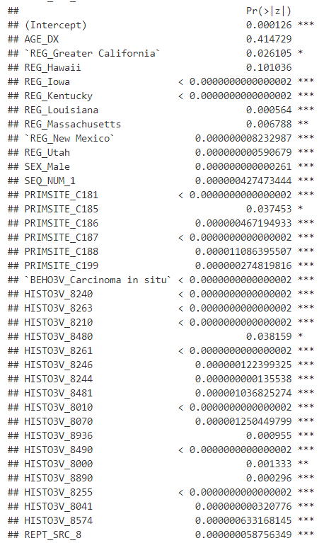
Logistic Regression
Final model
Final Output

Slide 8
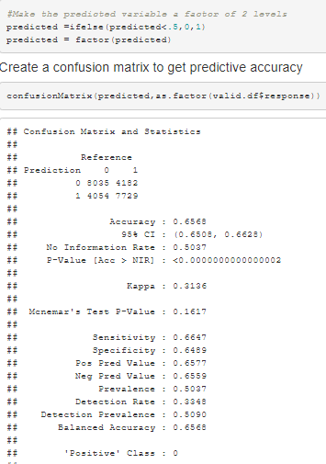
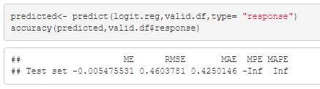
Evaluating Classification Performance
Final model can predict 65% of the validation data correctly
Before weighted sampling had 81%, but was classifying nearly all as class 0

Slide 9
Bias-variance tradeoff
Overall accuracy can be misleading
e.g. we can get 74% accuracy, but it ignores a class value that is represented by 30% of the data.
Tree-based ensemble models tend to reduce the variance
Overfitting issues
The cross-validation estimator is nearly unbiased
The bias will tend to be pessimistic (that is, overestimate the error), which is good

Slide 10
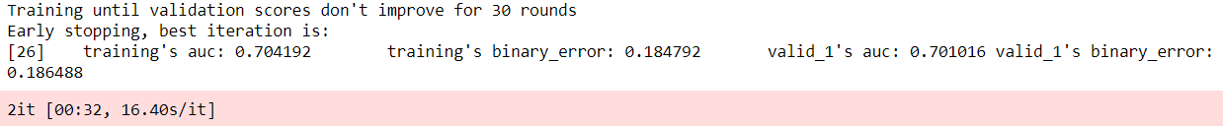
Light Gradient Boosting Machine
Light GBM is a gradient boosting framework that uses tree-based learning algorithm
Light GBM grows tree vertically while other algorithm grows trees horizontally
With 5 folds, we get an unbiased AUC (0.702) and accuracy (81.5%)
Decently close to the state-of-the-art AUC (0.79) of average survivability prediction (source: https://www.researchgate.net/publication/318661649)

Slide 11
Interesting Insights
Females are slightly more likely to have aggressive cancer (β_males = -.17)
Iowa, Kentucky, Utah higher odds of aggressive cancer
New Mexico, Hawaii, Massachusetts lower odds
Originating sites of primary tumor were significant and contributed heavily to odds
Age has little effect at β=.0007, and is considered insignificant by the model
Notes:
Less progressive states had slightly higher odds. Perhaps, lifestyles contribute?

Slide 12
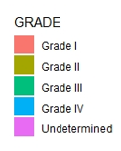
Insights: Histological Type
As suspected, histological type 8480 more likely to be grade 3 or 4 (β = .094)
8480 grouped in mucoepidermoid and neoplasms vs. adenomas and adenocarcinomas
Problems in this tissue have higher odds of being aggressive
β = Base | -1 | -.8 | .094

Slide 13
Reference
Stat software citation: Surveillance Research Program, National Cancer Institute SEER*Stat software (seer.cancer.gov/seerstat) version 8.3.4.
SEER data citation: Database name=Incidence - SEER 18 Regs Research Data + Hurricane Katrina Impacted Louisiana Cases, Nov 2016 Sub (1973-2016 varying) - Linked To County Attributes - Total U.S., 1969-2015 Counties.

Slide 14
Questions?

